Slide 1
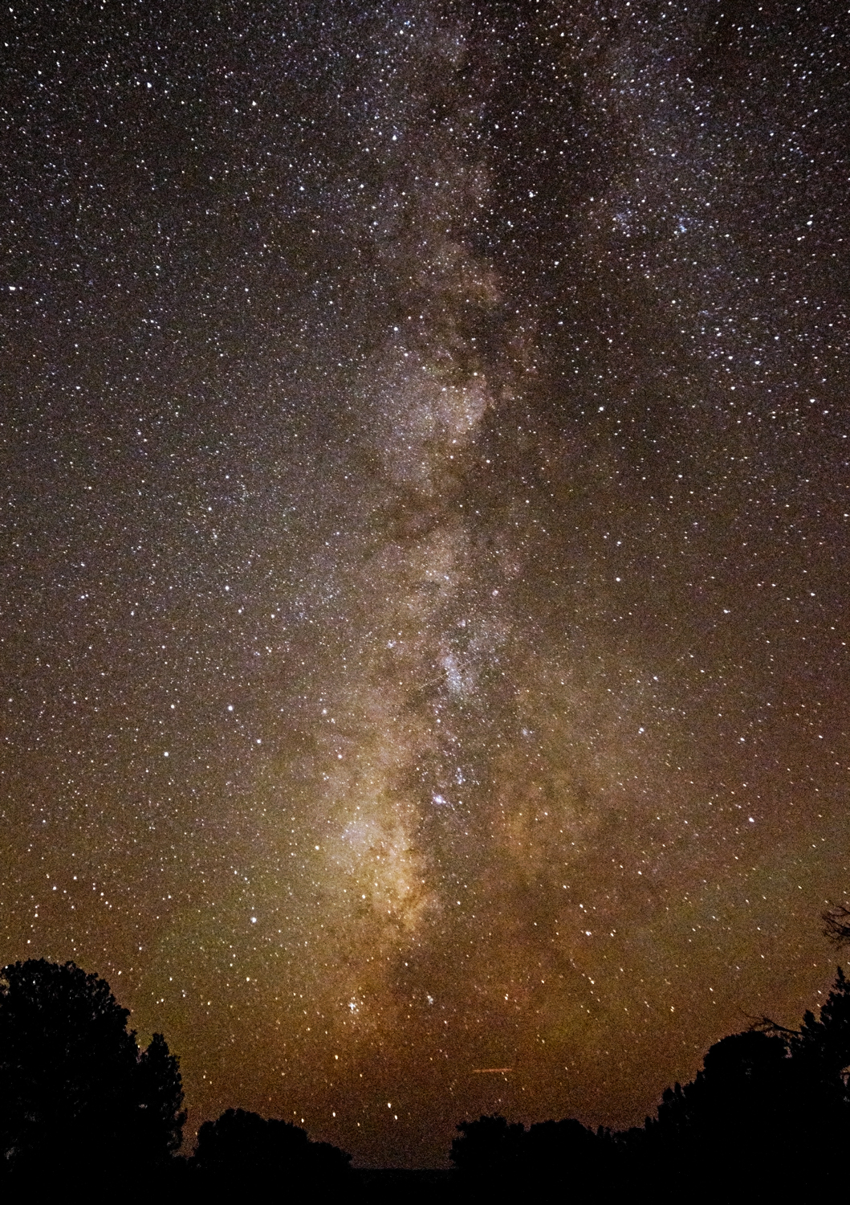
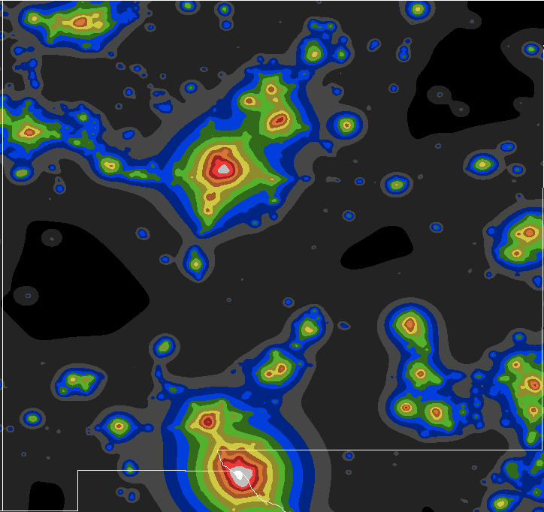
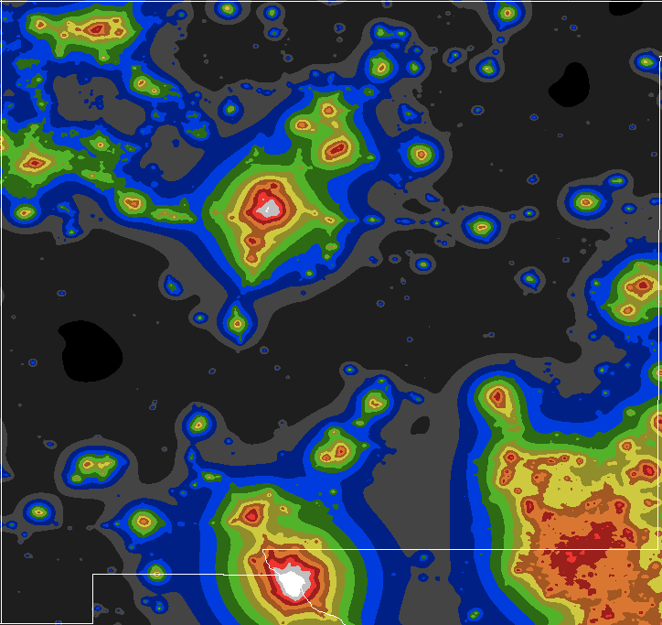
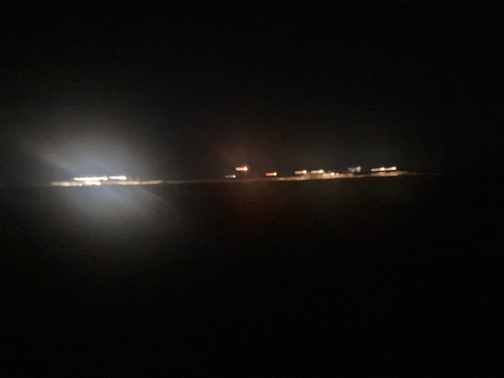
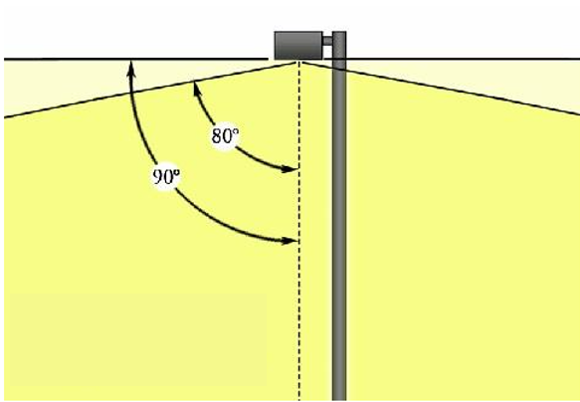
Protecting a valuable New Mexico Resource :
our night skies
SB34 : Updating the 1999 Night Sky Protection Act
2006
2022
We are losing our skies but we can save them!
Typical;
Dark sky compliant!
Oil and gas facilities
Keep light where it is needed!

